Slide 1

TASK-4
Prescriptive Analytics
SATISH NAGAR
DATA SCIENCE INTERN
AT HACKVEDA

Slide 2



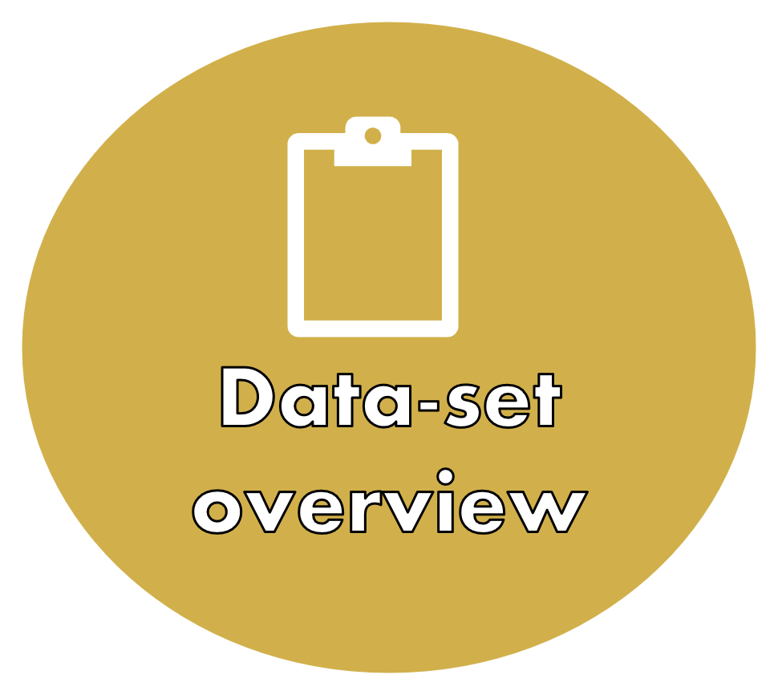


Slide 3



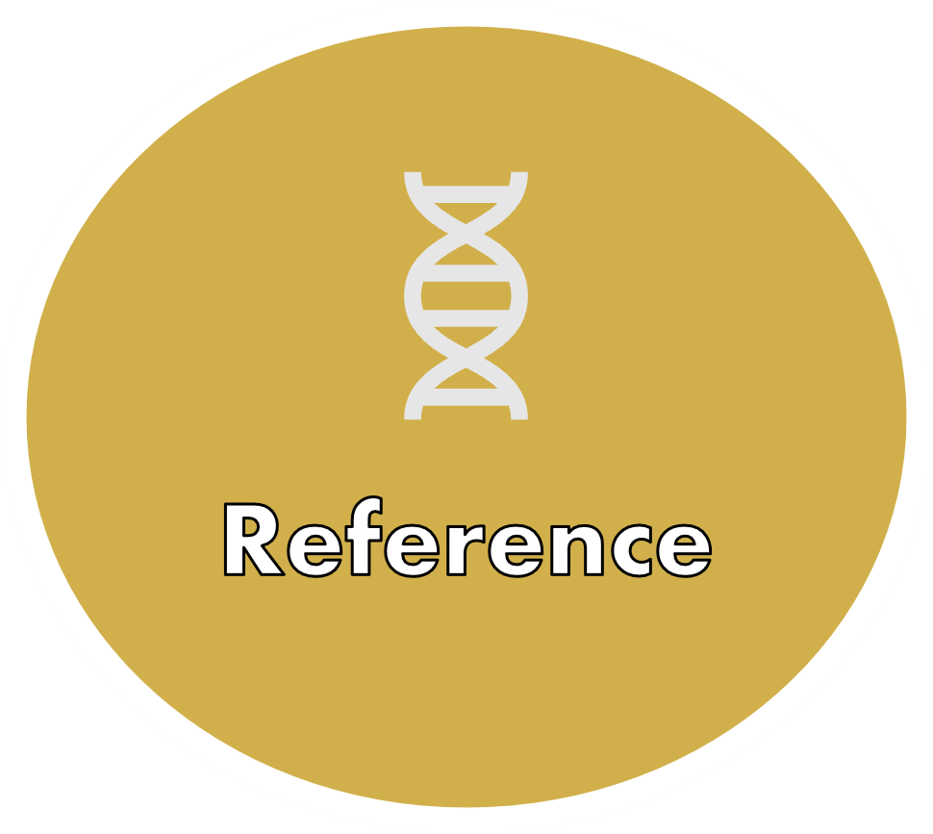
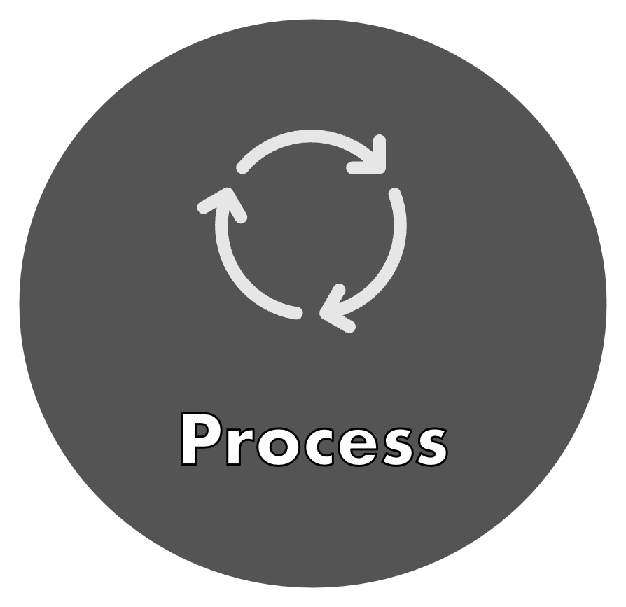

Slide 4



HOOK-STORY

Slide 5

Key Points:
Retail chain inventory management
Balance between stock levels and demand
Headphones sales example
Problems: overstocking and stockouts
Use of analytics to predict demand
Optimization techniques: linear programming, mixed-integer programming
Reduced costs and ensured right stock levels
Avoided overstocking and understocking
Improved sales, customer satisfaction, and profitability

Slide 6
Perfect Availability: Imagine a store where products are always available when needed.
Demand Prediction: Use data to predict demand in real-time.
Inventory Optimization: Maintain the right stock—no overstock or shortages.
Cost Efficiency: Reduce inventory costs while increasing profits.
Customer Satisfaction: Ensure customers always find what they need.
Data & Tools: Leverage data analytics and optimization techniques for smart inventory management.

Slide 7

OBJECTIVE
Optimization Algorithms: Use linear programming, integer programming, and mixed-integer programming to optimize inventory levels.
Impact Evaluation: Assess the impact of changes in parameters like demand, lead time, and holding costs.
Key Metrics: Evaluate the effectiveness of the solution using key metrics such as cost, revenue, and profit.

Slide 8

1.Importance of inventory management : A vital factor for profitability and operational efficiency.
Challenges: Issues like overstocking (tying up capital) and stockouts (lost sales).
Data-Driven Solutions: Utilizing optimization techniques to address inventory challenges.
Objective: Achieve an optimal balance between supply and demand.
Prescriptive Analytics: Employing advanced analytics to ensure accurate inventory levels.
INTRODUCTION

Slide 9

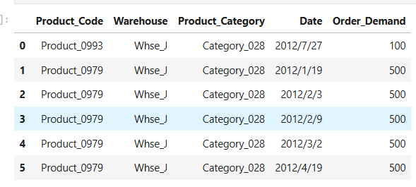
The dataset, "Product Demand Forecasting" from Kaggle, contains historical demand data for various products across different warehouses and time periods.
Key columns include:
Product_code: Names of the products.
Order_Demand: Historical demand values.
Date: The date the demand was recorded.
Warehouse: Warehouse locations of inventory.
Data-set overview

Slide 10

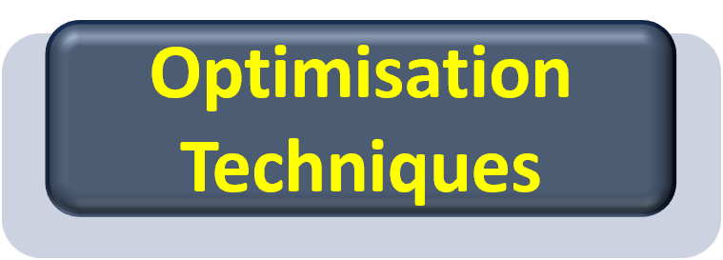

PROCESS
DATA COLLECTION
PREDICTIVE ANALYSIS
PRESCRIPTIVE ANALYSIS
Load and Explore the Dataset.
Data Cleaning.
The data and testing sets split the data into training and testing set
build and a train productive models.
Evaluate model performance using Matrix such as RMSe and MAE
Use optimisation technique to decide on inventory level based on predicted demand
Generate Excel recommendation for inventory management
data = pd.read_csv('path_to_file')
data.head()
data['Date'] = pd.to_datetime(data['Date'], errors='coerce')
data.fillna(data.mean(), inplace=True)

Slide 11
Evaluation matrices
Evaluate the optimization model's performance using key business metrics:
Cost: Total cost of holding inventory.
Revenue: Revenue generated from fulfilling demand.
Profit: Difference between revenue and costs, indicating profitability.

Slide 12
Optimisation Techniques
Optimization Techniques: This step involves using optimization algorithms to calculate the optimal inventory levels based on historical demand and cost parameters.
Linear Programming: Minimizing cost with continuous variables.
Integer Programming: Optimizing inventory levels with integer constraints (no fractional units of inventory).
Mixed-Integer Programming: Combining both continuous and integer variables to represent more realistic inventory problems.

Slide 13



Project implementation

Slide 14

Conclusion
This project successfully demonstrates how prescriptive analytics and optimization techniques can be used to enhance inventory management. By applying linear, integer, and mixed-integer programming, we have identified optimal inventory levels that balance cost and demand. The solution not only reduces costs but also ensures that products are available when needed, thereby improving profitability. Sensitivity analysis further allows businesses to understand how changes in parameters affect the solution, providing valuable insights for decision-making.

Slide 15
REFERENCE
Kaggle : https://www.kaggle.com/felixzhao/productdemandforecasting
Youtube: https://www.youtube.com/watch?v=wOuPbNqvLPQ&t=2029s
ChatGpt:
https://chatgpt.com

Slide 16





For any queries,
feel free to reach out at
Contact
satishnagar248@gmail.com
www.linkedin.com/in/satish-nagar-nilu

Slide 17
Thank-you☺

